Slide 1
Users’ attitudes to realistic TTS voices:
Is there an auditory uncanny valley?
Alice Ross
0236853@ed.ac.uk
MSc Developmental Linguistics 21-22
Supervisors:
Dr Catherine Lai
Prof Martin Corley

Slide 2
Uncanny valley effect
The uncanny valley effect (UVE) was first proposed by roboticist Masahiro Mori in 1970.
It predicts a tendency for humans to perceive highly realistic humanoid robots as unsettling; a dip or ‘valley’ in an otherwise positive correlation between realism and pleasantness or likeability.
Notes:
I’m skipping the part where I would usually talk about how important TTS is! But it is - used in a huge range of contexts, some of them life-saving

Slide 3
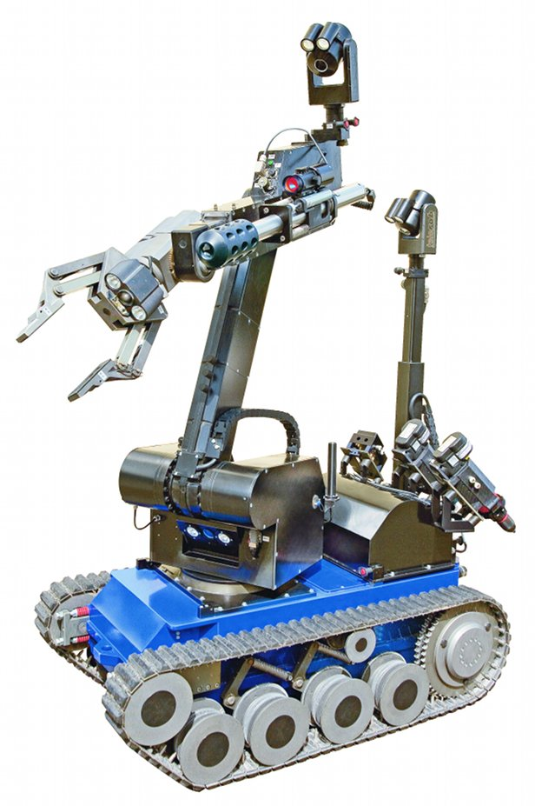
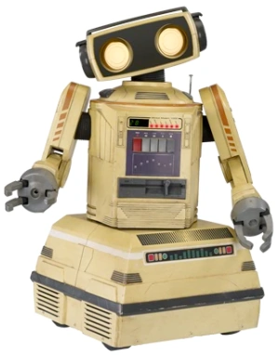
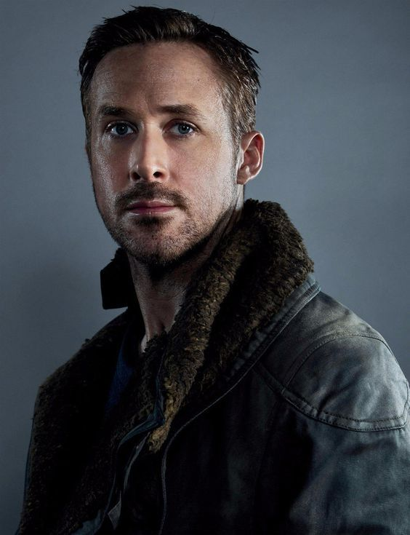
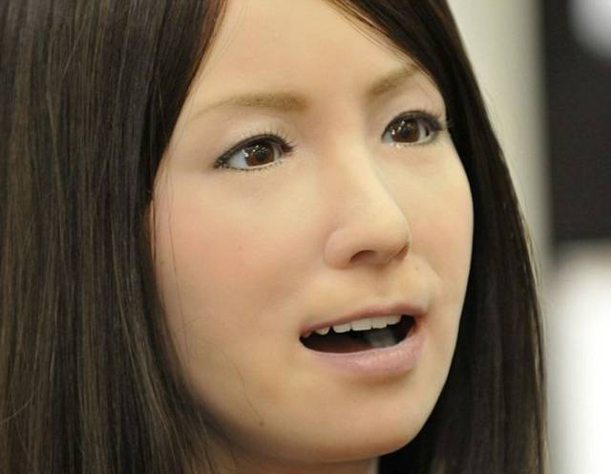
Not creepy | Not creepy | Creepy | Not creepy
Although the hypothesis isn’t new, UVE is still a current topic with plenty of ongoing research. It’s been studied in artificial faces, bodies, movements, hands…
People who aren’t roboticists are now increasingly likely to encounter AI agents, ‘virtual humans’, and especially natural language interfaces like Siri or Alexa in everyday contexts.
Notes:
Possible explanations for UVE include self-preservation, the same disgust/fear response triggered by seeing a corpse; or distrust, suspecting that the android is trying to fool us.
Obviously, things have changed a lot since the 70s.

Slide 4
My research question:
Is there an auditory uncanny valley?
I want to compare users’ perceptions of an array of voices, asking about (at least) two dimensions: realism and pleasantness.
H1a: Users demonstrate a general preference for more realistic TTS voices over older, more ‘mechanical’ sounding ones.
H1b: There is a significant dip in this otherwise positive correlation between voice realism and approval, indicating that some users find very realistic, ‘almost human’ voices unpleasant.
I plan to have participants listen to a short passage of audio (or possibly watch a video with voiceover narration) then answer questions about their recall of what they heard. This requires them to evaluate the voice in a given context.

Slide 5
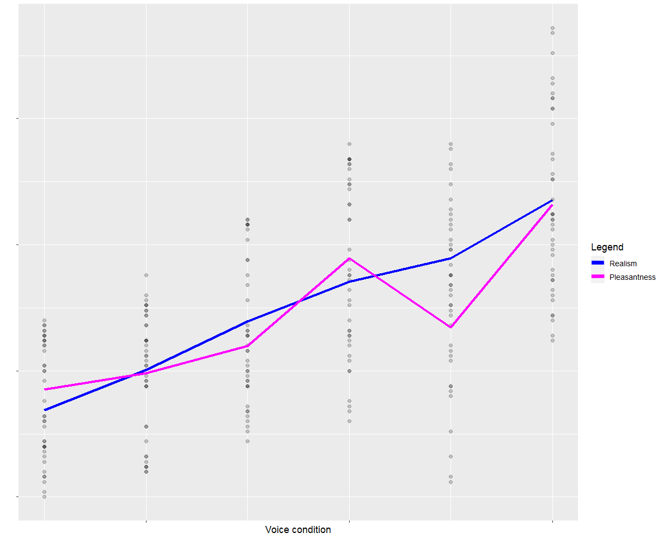
My research question:
Is there an auditory uncanny valley?
If there’s a significant uncanny valley effect, I would expect results to look something like this.
Please note this is NOT real data!
Notes:
I would be very happy if my results came out looking like this in a few months :)

Slide 6

Problem: Which voices to compare?
What would an array from ‘mechanical’ to ‘almost human’ look (sound) like?
KlattTalk ‘Perfect Paul’, 1984 | ? | CereProc ‘Stuart’, 202?
There are obvious problems with comparing these two:
People might prefer the Scottish accent (or not!)
Or some other dimension, like fundamental frequency, rate of speech…
Familiarity: one of the voices is pretty famous
Notes:
The KlattTalk voice was used by English physicist Stephen Hawking from 1986 until his death in 2018.

Slide 7
Existing studies on TTS
Researchers have investigated different dimensions of TTS:
Learning outcomes
Craig, S. D., & Schroeder, N. L. (2019). Text-to-Speech Software and Learning: Investigating the Relevancy of the Voice Effect. Journal of Educational Computing Research, 57(6), 1534–1548.
‘Gender’/pitch
Tolmeijer, S., Zierau, N., Janson, A., Wahdatehagh, J. S., Leimeister, J. M. M., & Bernstein, A. (2021, May). Female by Default?–Exploring the Effect of Voice Assistant Gender and Pitch on Trait and Trust Attribution. In Extended Abstracts of the 2021 CHI Conference on Human Factors in Computing Systems.
Mullennix, J. W., Stern, S. E., Wilson, S. J., & Dyson, C. L. (2003). Social perception of male and female computer synthesized speech. Computers in Human Behavior, 19(4), 407-424.
English-speaking accents
Tamagawa, R., Watson, C. I., Kuo, I. H., MacDonald, B. A., & Broadbent, E. (2011). The effects of synthesized voice accents on user perceptions of robots. International Journal of Social Robotics, 3(3), 253-262.
I looked at how they selected their voices.

Slide 8
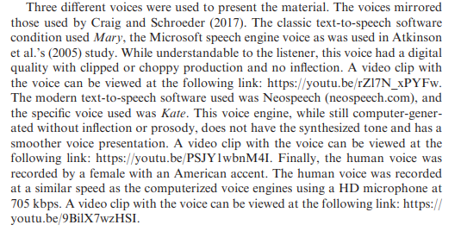
Existing studies on TTS
Learning outcomes
Craig, S. D., & Schroeder, N. L. (2019). Text-to-Speech Software and Learning: Investigating the Relevancy of the Voice Effect.
TLDR: Craig and Schroeder picked an ‘old’ voice (Microsoft Mary) and a ‘new’ one (Neospeech Kate)
But both voices were introduced in the early 2000s
The human control voice was recorded by ‘a female with an American accent’
Not the best in terms of controlling for variation.

Slide 9
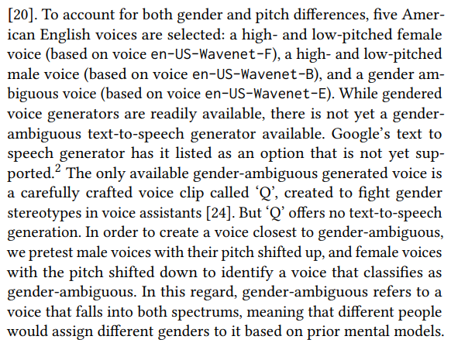
Existing studies on TTS
‘Gender’/pitch
Tolmeijer, S., Zierau, N., Janson, A., Wahdatehagh, J. S., Leimeister, J. M. M., & Bernstein, A. (2021, May). Female by Default?–Exploring the Effect of Voice Assistant Gender and Pitch on Trait and Trust Attribution.
Tolmeijer et al. picked three different US English Google WaveNet voices
Then modified the pitch to produce high-pitched and low-pitched versions of the ‘male’ and ‘female’ voices and ensure their fifth voice was as gender-ambiguous as possible
(Most listeners tend to categorise voices as either male or female, even when it’s not intuitive)

Slide 10
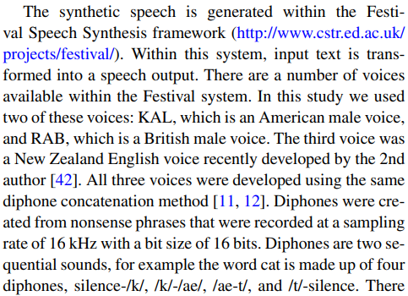
Existing studies on TTS
Accents
Tamagawa, R., Watson, C. I., Kuo, I. H., MacDonald, B. A., & Broadbent, E. (2011). The effects of synthesized voice accents on user perceptions of robots.
This study was on New Zealanders’ preferences for the voice of a healthcare robot
Tamagawa et al. used two Festival voices (UK and US accents), and created a third NZ accented one using the same method
They ‘ensured the sampling rate and bit-size for all three voices was the same. Therefore, the output synthesized speech was of the same quality in terms of how easy the speech was to listen to’.
Notes:
Everyone else in the room probably knows a lot more about Festival than I do!

Slide 11
Existing studies on UVE
Researchers have studied UVE in the visual realm
Broadly speaking, there are two approaches to selecting/creating stimuli arrays:
Selecting some existing items (robots, animations, CG faces etc), then using norming studies to arrange them along the ‘realism’ dimension
Using photomanipulation to create the stages ‘in between’ an artificial and real human stimulus

Slide 12
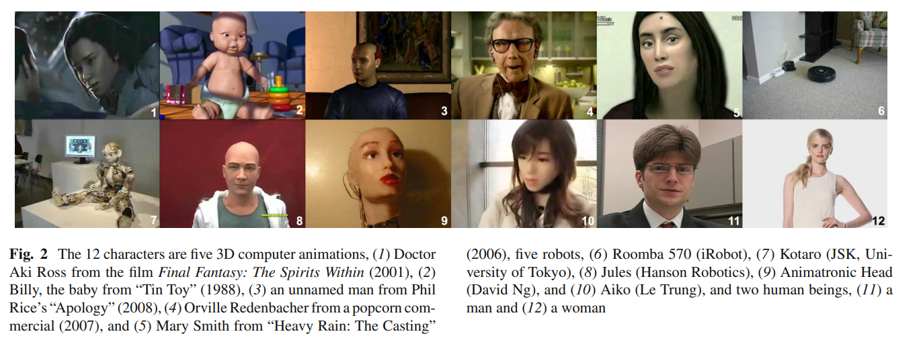
A.
Ho, C. C., & MacDorman, K. F. (2017). Measuring the uncanny valley effect. International Journal of Social Robotics, 9(1), 129-139.
“The aim was to select robots from typical demonstration settings and 3D computer models from a variety of genres—short films, machinima, advertisements, and videogames—in addition to feature-length films. Two humans were added to extend the range of humanness.”
Notes:
The stimuli vary so much in age and gender as well as realism - it might’ve been best if it were possible to match the ‘human-like’ ones against controls (so a real baby vs the computer animated baby)?

Slide 13
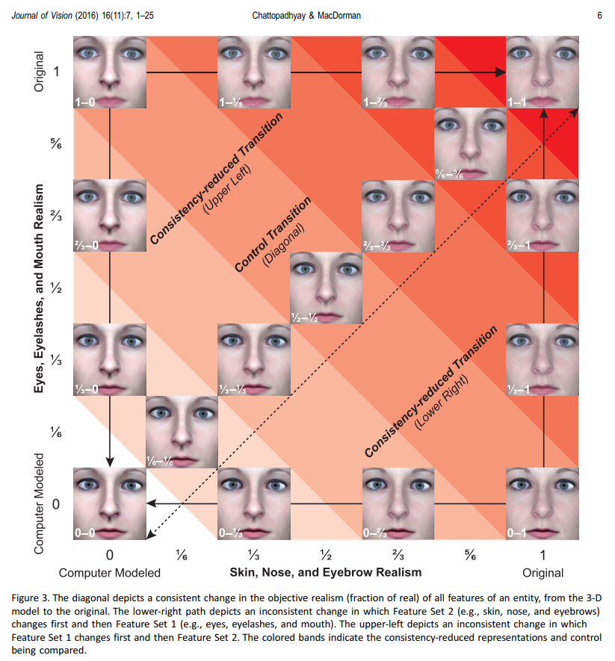
B.
Chattopadhyay, D., & MacDorman, K. F. (2016). Familiar faces rendered strange: Why inconsistent realism drives characters into the uncanny valley. Journal of vision, 16(11), 7.

Slide 14
Back to my study
So, two possible strategies for my voice array:
Pick some existing TTS voices and arrange them using a norming study
Keep them as similar as possible on all but one dimension: they should have the same fundamental frequency, accent, loudness, rate of speech, etc.
How many?
Take one or two voices (e.g. a very ‘robotic’ voice and a real human one), then modify them to create ‘in between’ versions
How do we define ‘realism’ acoustically?
How do we modify them?
How many?
Notes:
My intuition is that pitch fluctuation might create ‘realism’? It could go from 0 variation, completely flat, to ‘whatever a real person does’, but it could also go ‘too far’ - ignoring the patterns of which pitches follow one another
Can we make a really flat version of Linda Johnson?

Slide 15
Over to you
What makes TTS voices sound good or bad? Are there any common problems you’ve faced when trying to make them sound more ‘real’?
Another potential concern is about familiarity and novelty. I suspect many of my participants will likely be used to a given voice from using voice assistants. Is this something people have tackled before in TTS evaluations?
Perhaps it’d be better to have them explicitly compare two stimuli and say which one’s better. That might help to situate the voices in a context so they’re not implicitly comparing whatever they hear to, e.g., Siri?
Notes:
‘Realism inconsistency’ might cause UVE effects (Chattopadhyay & MacDorman, 2016); perhaps I could try some voices with wildly or slightly inconsistent vowel duration, loudness, etc?

Slide 16
Thanks for listening!
Please feel free to get in touch with me:
github.com/alice-ross
Teams - Alice Ross
or 🔗 email

